Slide 1







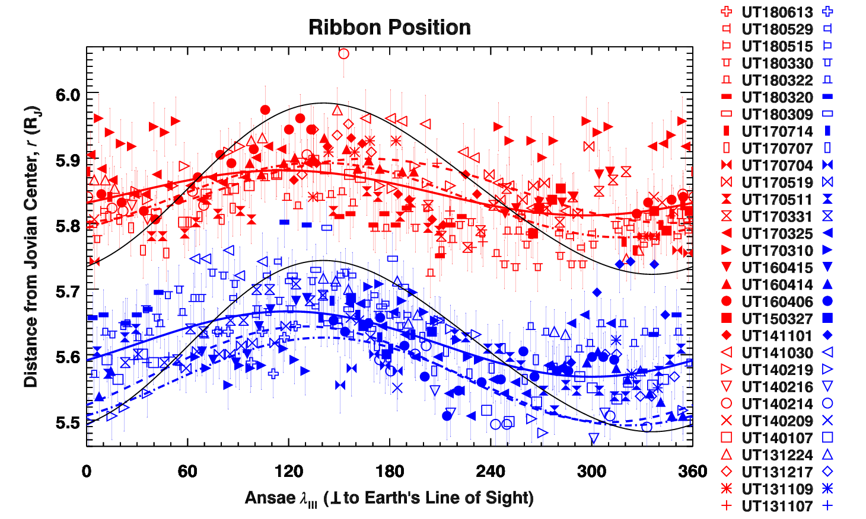
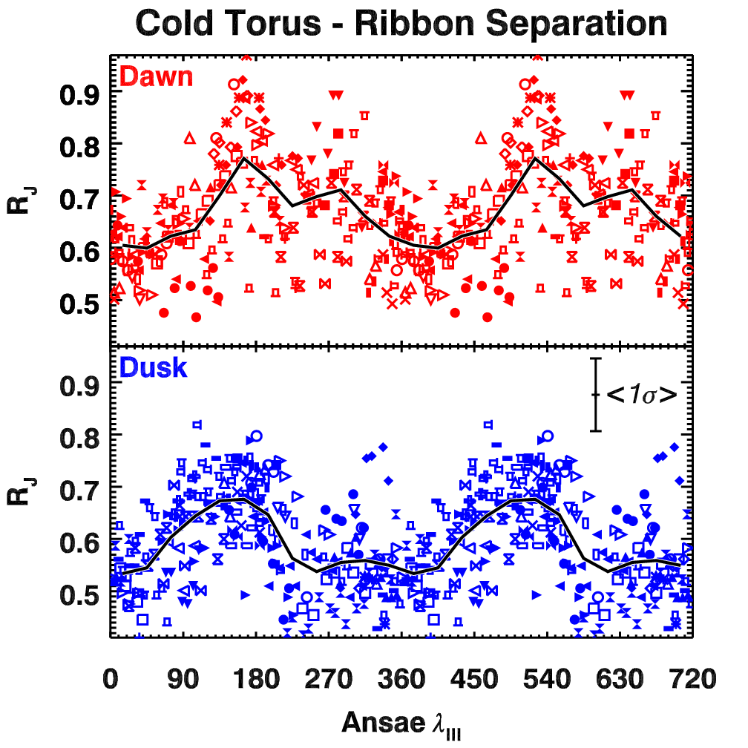
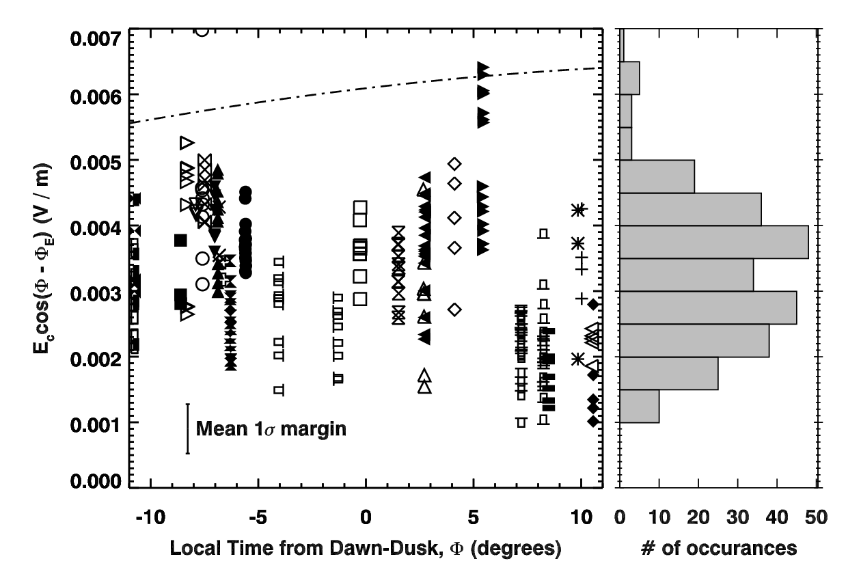
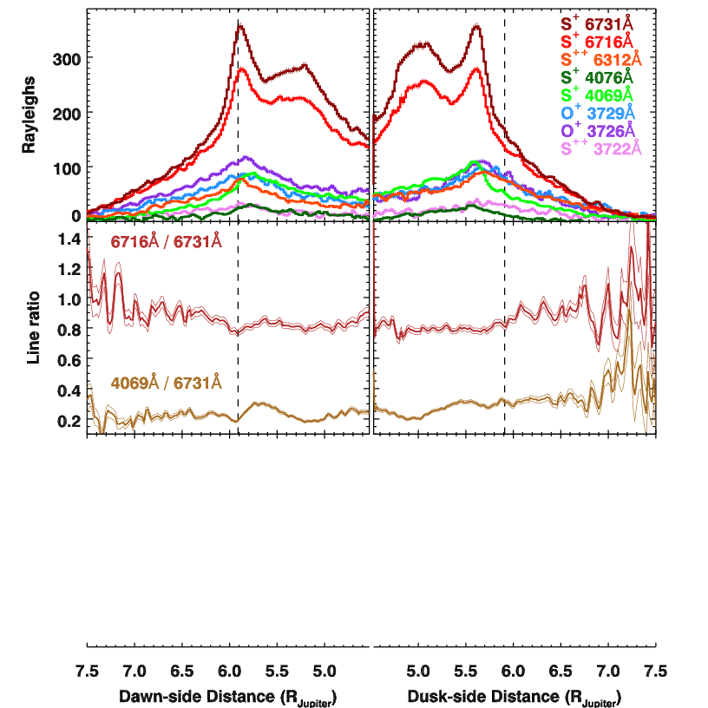
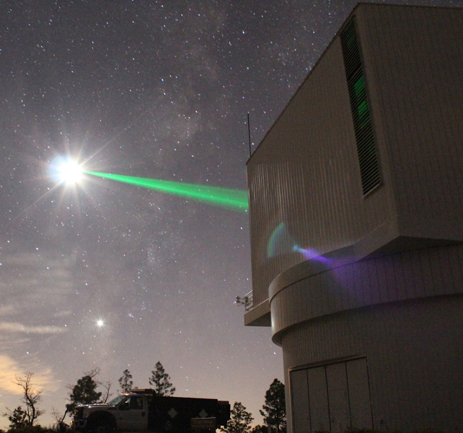
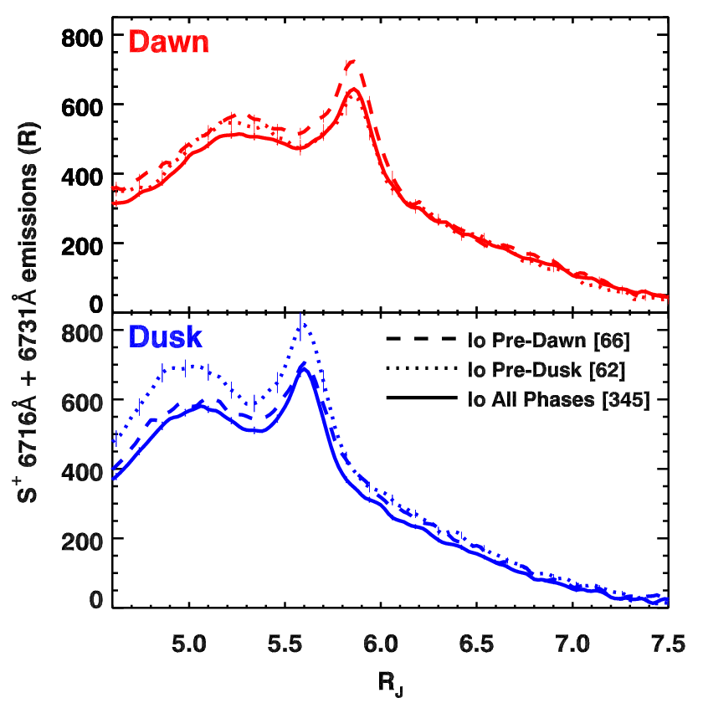
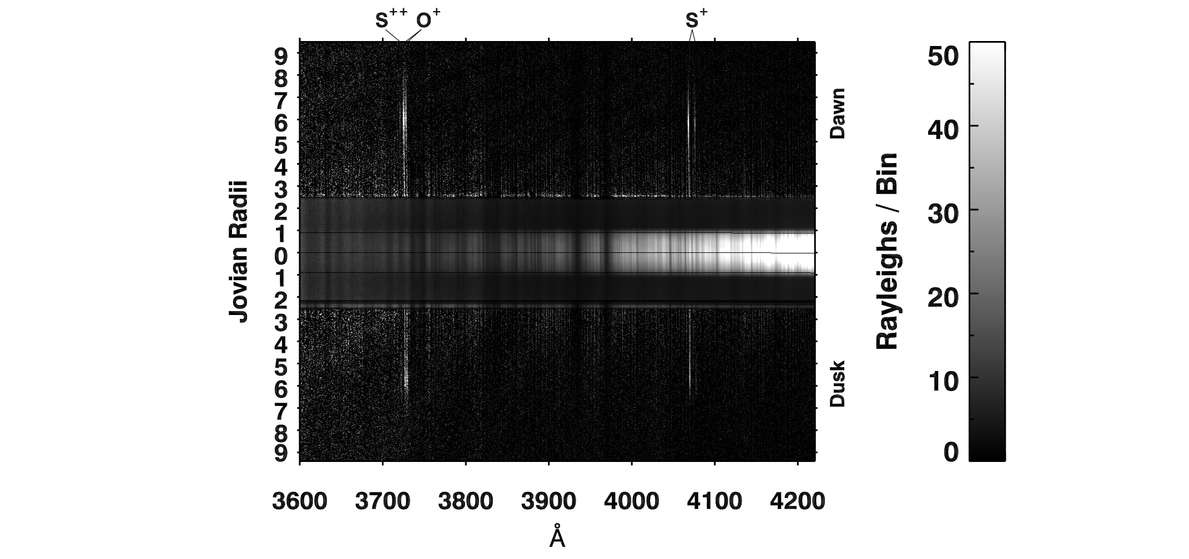
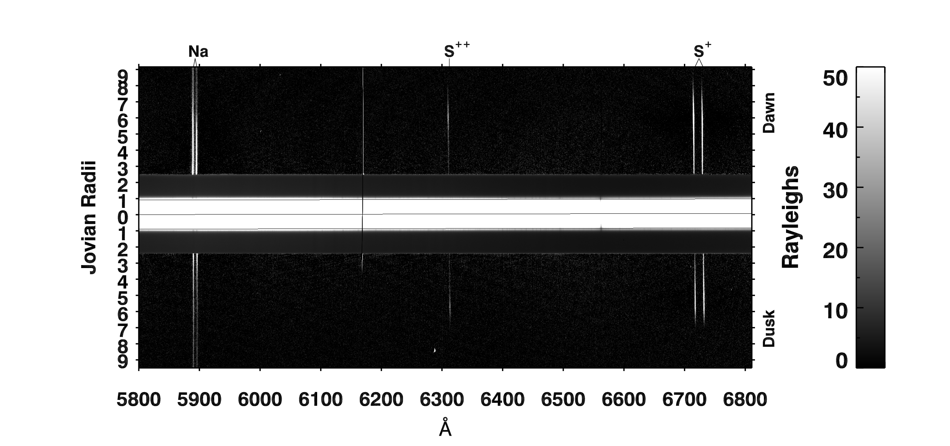
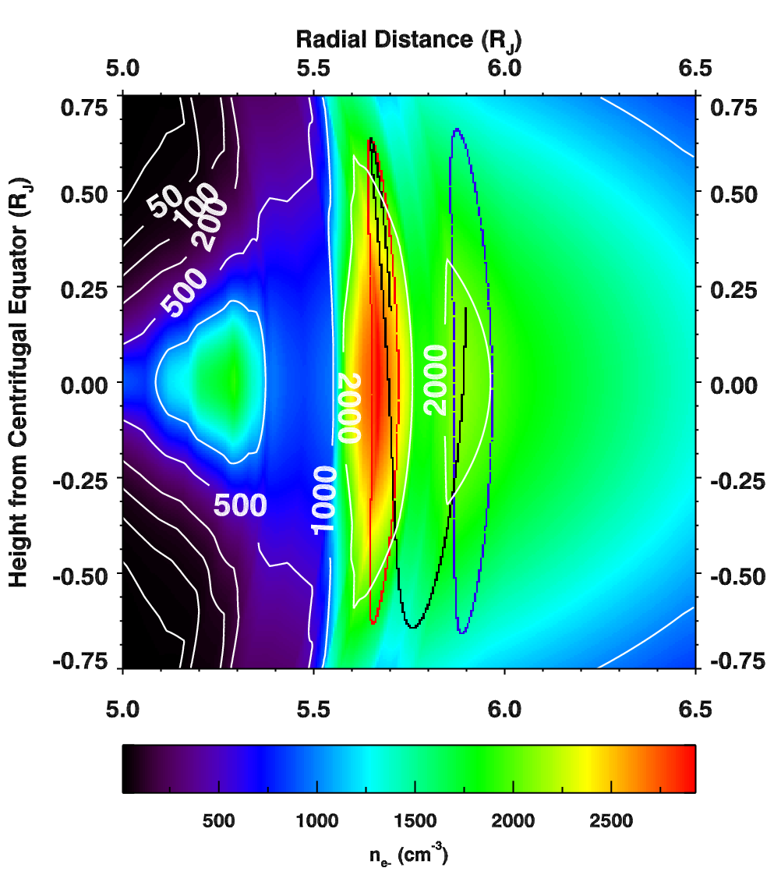
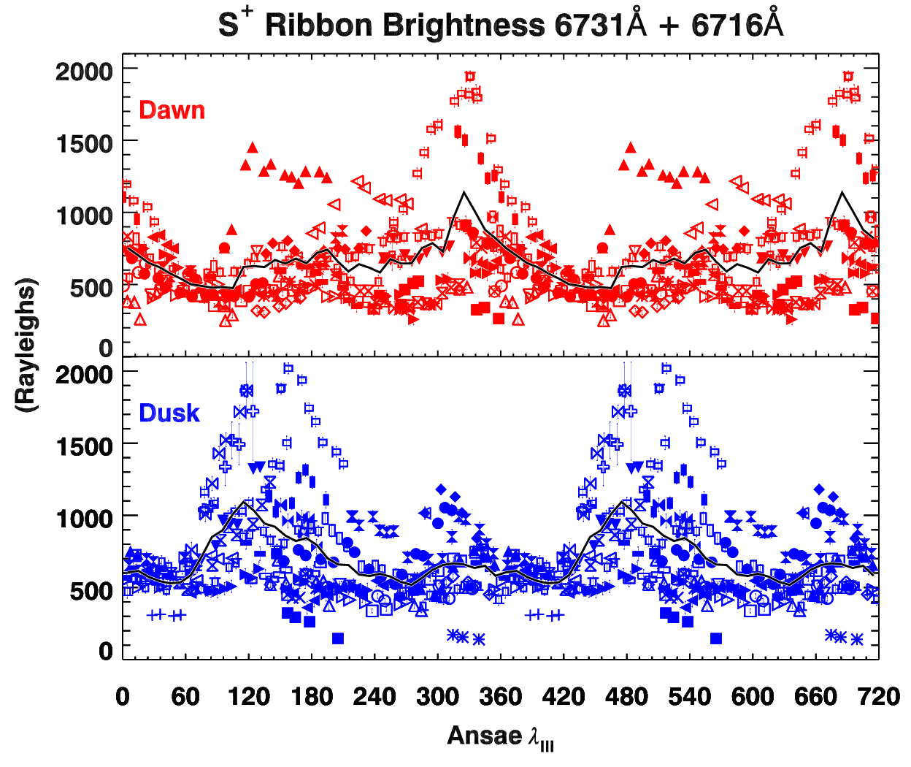
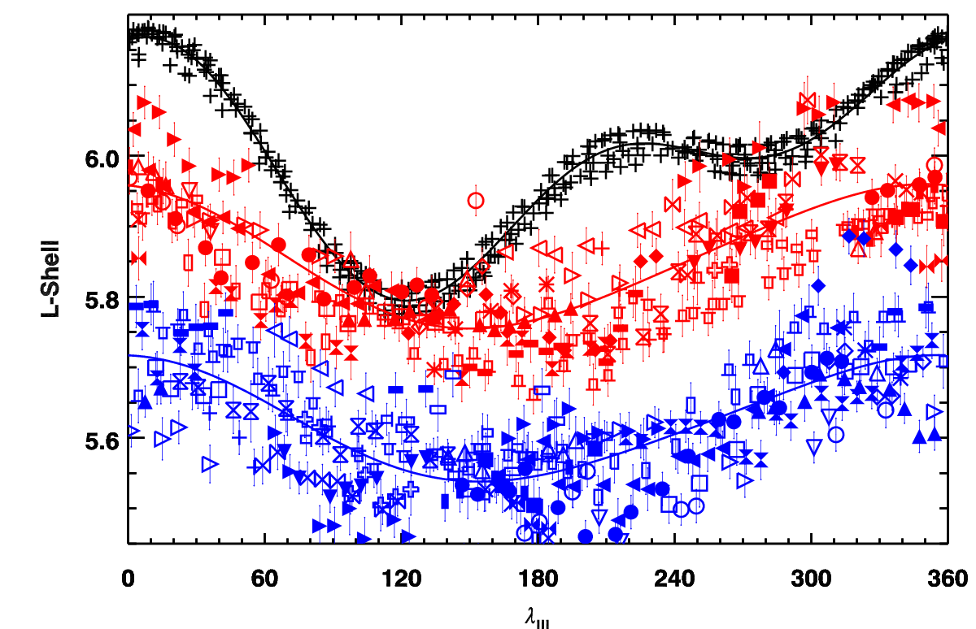
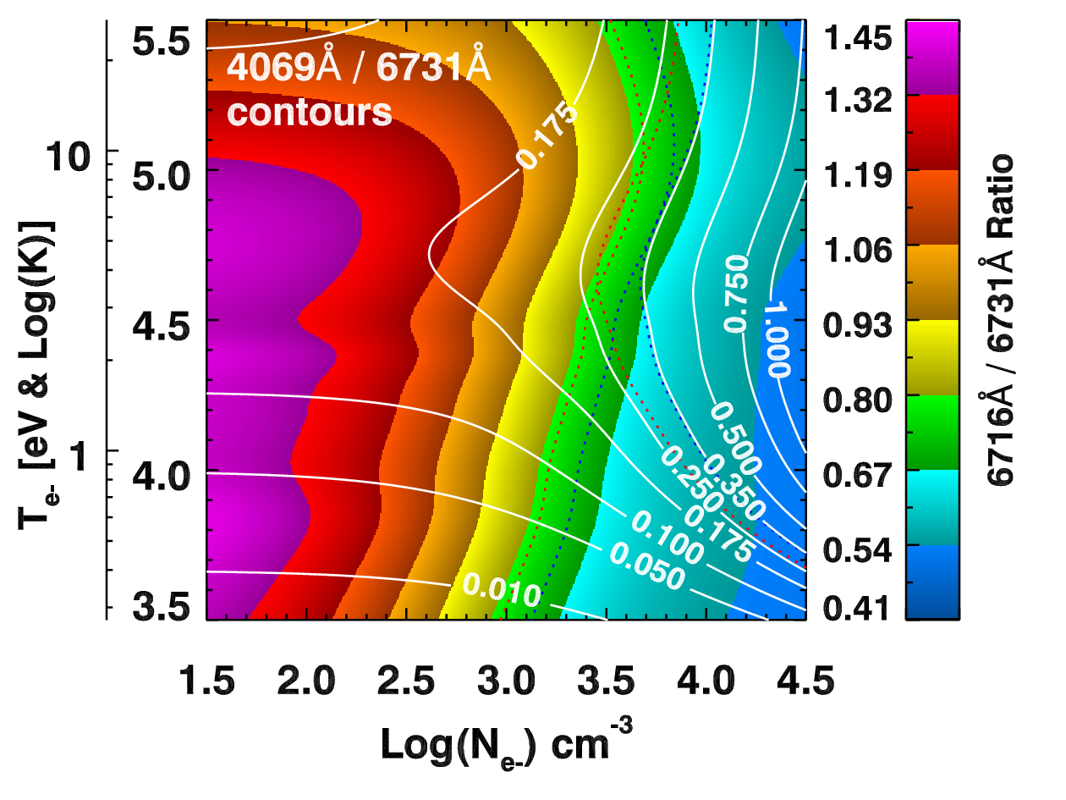
Visible Wavelength Spectroscopy of the Io Torus During the Hisaki Mission
^{1,3}Schmidt, C. A., ²Schneider, N., ³Leblanc, F., ⁴Gray, C., ⁵Morgenthaler, J., ⁶Turner, J., ⁷Grava, C.
¹BU CSP, ²CU LASP, ³LATMOS IPSL, ⁴NMSU, ⁵PSI, ⁶UVA, ⁷SWRI
Abstract
Radial Location of the Torus
Dawn-Dusk E-Field
Emissions in Io's torus offer a unique opportunity to snap a picture of a magnetosphere through the lens of a telescope. We report on spectroscopic observations with the ARC 3.5m at Apache Point Observatory, measuring radial distributions of eight emission lines of S⁺, O⁺, and S⁺⁺ at visible wavelengths. The results complement and independently confirm key Hisaki findings. The torus' dawn-dusk displacement is consistent with the electric field strength (3.8 mV/m) and variability (1-8 mV/m) inferred from the EUV brightness asymmetry. As in the EUV, the visible torus also shows brightness enhancements at longitudes near the intersection of the orbital and centrifugal planes. Previously unseen characteristics yield additional insights. Emission enhancements downstream of Io are observed for the first time in the visible. This Io phase effect differs from that in the EUV and lags further behind the immediate wake. Such may reflect density and temperature perturbations as the plasma sweeps past Io, offering important clues about how the moon's atmospheric loss supplies the torus. Inner cold torus emissions are only observed from S⁺ transitions <2eV. Radial distances to the cold torus and ribbon features depend on Jovian longitude in distinctly different ways, posing new information about how Jupiter's field regulates the plasma transport in these populations.
The offset between ansae owes to a dawn-dusk E-field. This field’s strength is too variable to identify the local-time offset that Sandel & Broadfoot (1982) and Smyth et al. (2011; dash-dot) proposed.
The dawn-side (approaching) ansa of the ribbon is 0.23 R_{J} farther from Jupiter than the dusk-side (receding). Black lines trace the centrifugal limit along a constant magnetic L-shell. Blue lines compare sinusoidal fits to Schneider & Trauger (1995; dashed) and Smyth et al. (2011; dot-dashed).
Herbert et al. (2008) showed the latitudinal separation of the cold-torus and ribbon varies with Jovian longitude. We find that longitude also modulates their radial separation.
Temperature & Density
Plasma Torus Observations
Io’s Phase Effect
Hisaki’s emissions brighten down-stream of Io. Unlike in the UV, bright Io contaminates visible spectra. Our narrow slit aperture can at times isolate the torus, offering the first evidence of an Io phase effect in the visible. Profiles 45⁺30° down-stream of Io are shown here.
Herbert et al. (2008)
Co-adding the data, it can constrain plasma parameters in the inner torus, a dense region nearly invisible in the UV. The innermost feature appears only in the transitions <2 eV, offering an upper limit on the cold-torus e⁻ temperature. S⁺ line ratios, traced by dotted lines below, differ at dawn & dusk. Averaged over the sight column, 3500-4000 cm⁻³ and 5 eV appear characteristic of the ribbon plasma, but line of sight needs to be corrected for… yet TBD.
The above imaging study nicely exhibits the inner cold torus near 5 R_{J} and tall ribbon plasma populations of S⁺. The same technique of masking Jupiter with a 10⁻³ filter and pivoting to subtract its scattered light is used here. A long slit aligned with the torus gives the spectrum below.
Tsuchiya et al. (2015)
Apache Point Observatory 3.5m
Periodic Emissions & Potential Drivers
Dawn
Io’s last passage (+)
10⁻³
Mask
Jupiter
Dusk
Blue Channel
Red Channel
Apache Point Observatory
The ribbon nearly always passes interior to Io in magnetic coordinates.
345 spectra over 30 nights; largest yet spectroscopic survey in the visible.
Jupiter in field allows for a simple pointing reference and calibration standard
Long-slit spectroscopy spans the entire torus, tracking it at ~15 min cadence
Dual red and blue optical channels measure S⁺, S⁺⁺, O⁺ and Na emissions
Jovian rotation modulates emission, albeit differently from the “active region” past studies reported. Brightest points plausibly owe to the May 10th 2018 volcanic event reported by de Kleer. The plasma density sweeping past Io (middle) or the Io-ribbon magnetic separation at last conjunction (right) would seem good candidates for a driver, yet, neither yields a strong statistical correlation.
Contact --- schmidtc@bu.edu

